Slide 1
Causal Inference Crash Course Part 5: Heterogeneous Treatment Effect Models and Inference
Julian Hsu

Slide 2
Causal Inference Series
Foundations
Defining Some ATE/ATET Causal Models
ATE/ATET Inference, Asymptotic Theory, and Bootstrapping
Best Practices: Outliers, Class Imbalance, Feature Selection, and Bad Control [skipped for now]
Heterogeneous Treatment Effect Models and Inference
Difference-in-Difference Models for Panel Data
Regression Discontinuity Models
Arguable Validation

Slide 3
Overview
This presentation covers the general problem of estimating heterogeneous treatment effects (HTE) and how it differs from ATE/ATET estimation.
Covers a few models:
Double Machine Learning following Semenova et al. (2021)
Heterogeneous Residuals
Causal Forests / Local Linear Forests
Doubly Robust models following Kennedy (2020)
Wrap up with a simulation demonstration

Slide 4
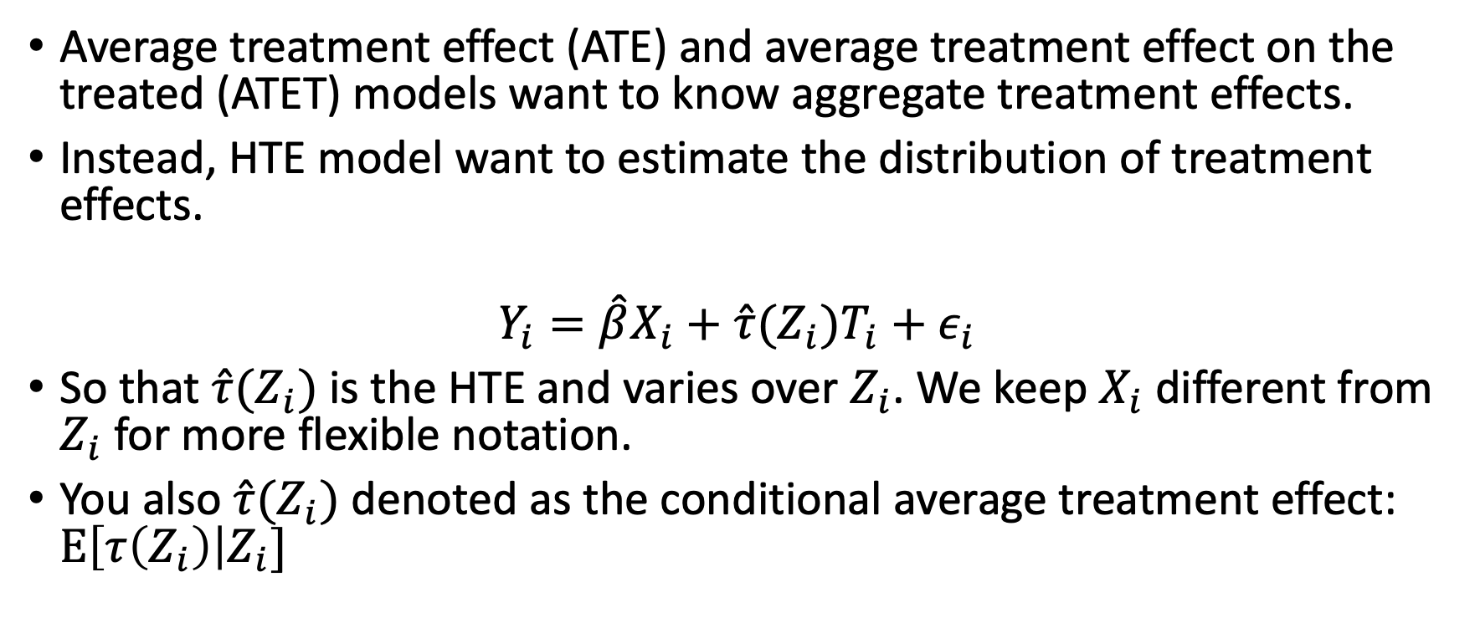
HTE Overview
Average treatment effect (ATE) and average treatment effect on the treated (ATET) models want to know aggregate treatment effects.
Instead, HTE model want to estimate the distribution of treatment effects.
$$Y_{i}=\hat{β}X_{i}+\hat{τ}(Z_{i})T_{i}+ε_{i}$$
So that $\hat{τ}(Z_{i})$is the HTE and varies over $Z_{i}$. We keep $X_{i}$ different from $Z_{i}$ for more flexible notation.
You also $\hat{τ}(Z_{i})$ denoted as the conditional average treatment effect: $E\left[τ\left(Z_{i}\right)\right|Z_{i}]$
Notes:
Note that inference and standard errors is *required* for HTE models, just like for ATE/ATET models.

Slide 5
HTE as an estimated function
We want to estimate the functional form of HTE.
When estimating ATE/ATET, we are only concerned with the average. We can assume linearity as well.
We average over more granular treatment effects.
Estimating more granular treatment effects means there are additional challenges.

Slide 6
How much variation do we want in HTE?
Two extremes:
1. Individualized treatment estimates allow more flexibility, but can demand large sample sizes and variation in data.
Increases the risk of noise driving estimates
2. Segmented estimates are the least inflexible, with the least risk of noise driving estimates.
In-between case is to allow treatment effects to vary across some dimensions, but not others.

Slide 7
HTE ideal experiment
We can understand these two extreme based on what the ideal experiment is to estimate unbiased HTE.
For individualized HTE, the ideal is to randomize treatment for each individual. (impossible)
For segmented HTE, the ideal is to randomize treatment for each segment. (stratified randomization)
The more individualized HTE is, the more data and assumptions are needed to distinguish between real patterns and statistical noise in the data.

Slide 8
HTE inference challenge
Statistical inference for ATE/ATET estimates is based on the distribution of error around the average estimate.
The challenge is getting a distribution around an individual estimate.
The solution is to rely on either model specifications or bootstrapping-esque methods.

Slide 9
Some HTE Models

Slide 10
Support across use cases
 | Cross Sectional Data | Panel Data | Continuous Treatment
DML – Semenova et al. | Y | Y | Y
DML – Heterogeneous Residuals | Y | Y | Y
Generalized Random Forests | Y | N | N
Doubly Robust – Kennedy (2020) | Y | N | N

Slide 11
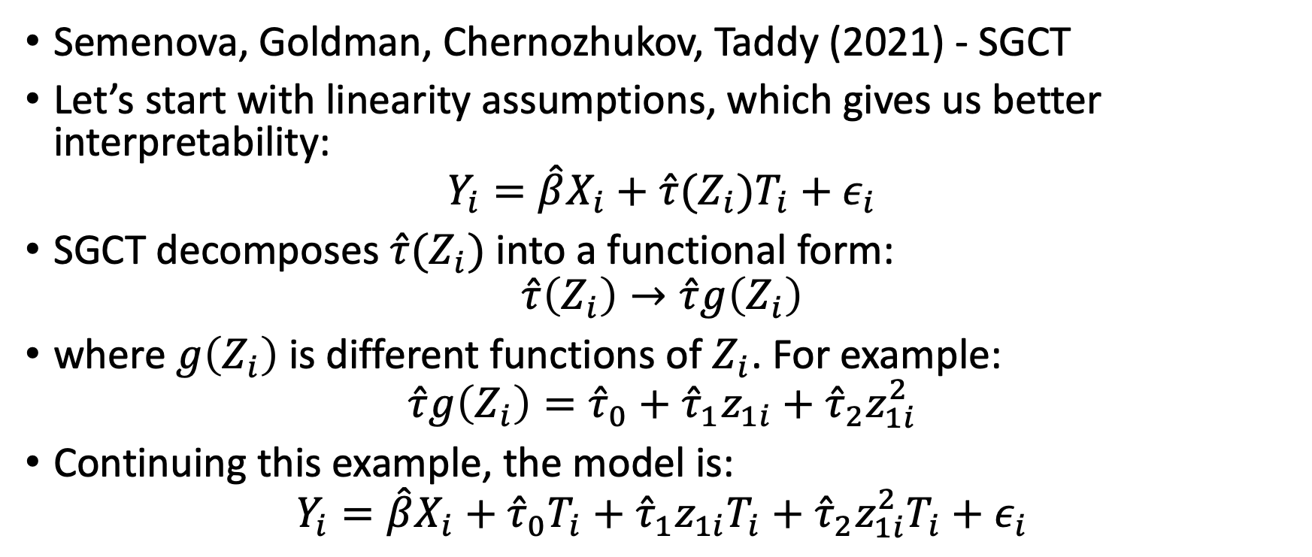
DML-Style Models
Semenova, Goldman, Chernozhukov, Taddy (2021) - SGCT
Let’s start with linearity assumptions, which gives us better interpretability:
$$Y_{i}=\hat{β}X_{i}+\hat{τ}(Z_{i})T_{i}+ε_{i}$$
SGCT decomposes $\hat{τ}(Z_{i})$ into a functional form:
$$\hat{τ}\left(Z_{i}\right)→\hat{τ}g\left(Z_{i}\right)$$
where $g\left(Z_{i}\right)$ is different functions of $Z_{i}$. For example:
$$\hat{τ}g\left(Z_{i}\right)={\hat{τ}}_{0}+{\hat{τ}}_{1}z_{1i}+{\hat{τ}}_{2}z_{1i}^{2}$$
Continuing this example, the model is:
$$Y_{i}=\hat{β}X_{i}+{\hat{τ}}_{0}T_{i}+{\hat{τ}}_{1}z_{1i}T_{i}+{\hat{τ}}_{2}z_{1i}^{2}T_{i}+ε_{i}$$

Slide 12
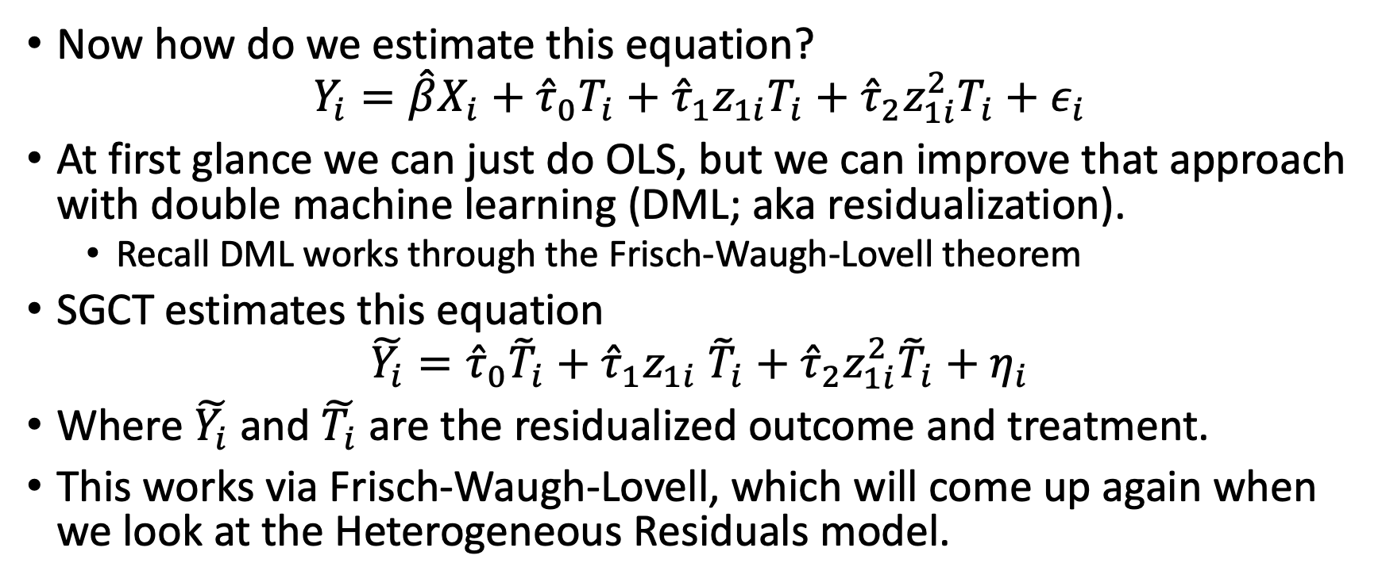
SGCT uses residualization
Now how do we estimate this equation?
$$Y_{i}=\hat{β}X_{i}+{\hat{τ}}_{0}T_{i}+{\hat{τ}}_{1}z_{1i}T_{i}+{\hat{τ}}_{2}z_{1i}^{2}T_{i}+ε_{i}$$
At first glance we can just do OLS, but we can improve that approach with double machine learning (DML; aka residualization).
Recall DML works through the Frisch-Waugh-Lovell theorem
SGCT estimates this equation
$$\tilde{Y_{i}}={\hat{τ}}_{0}{\tilde{T}}_{i}+{\hat{τ}}_{1}z_{1i} {\tilde{T}}_{i}+{\hat{τ}}_{2}z_{1i}^{2}{\tilde{T}}_{i}+η_{i}$$
Where $\tilde{Y_{i}}$ and $\tilde{T_{i}}$ are the residualized outcome and treatment.
This works via Frisch-Waugh-Lovell, which will come up again when we look at the Heterogeneous Residuals model.

Slide 13
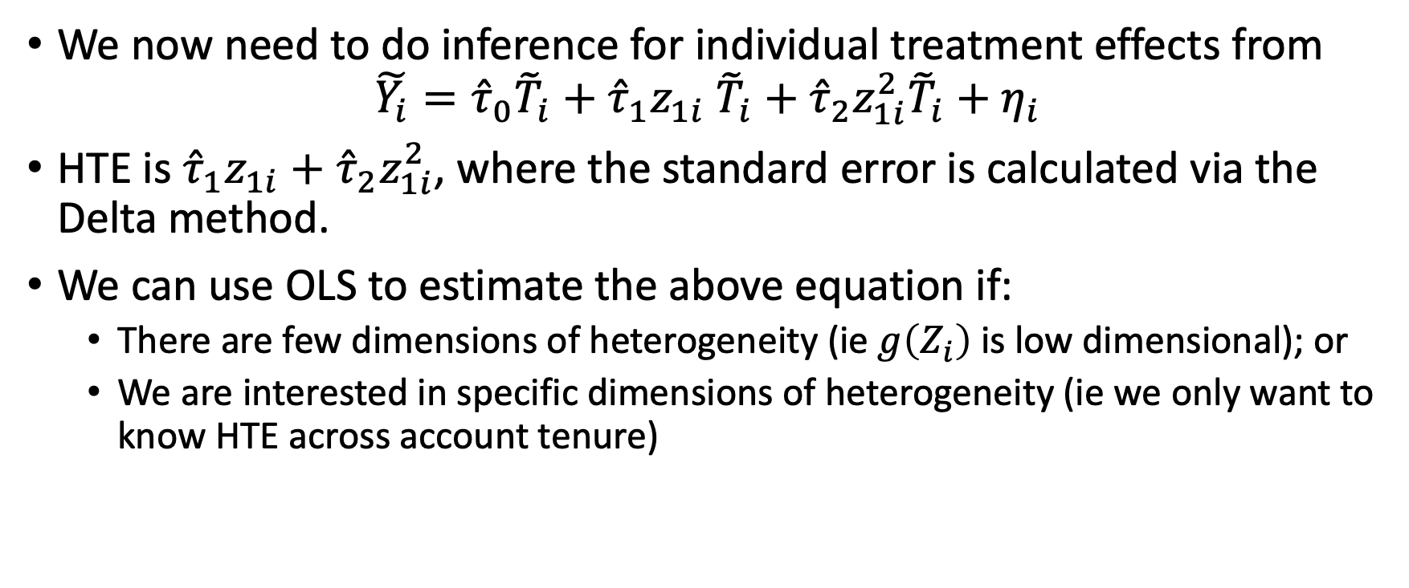
SGCT – HTE and inference
We now need to do inference for individual treatment effects from
$$\tilde{Y_{i}}={\hat{τ}}_{0}{\tilde{T}}_{i}+{\hat{τ}}_{1}z_{1i} {\tilde{T}}_{i}+{\hat{τ}}_{2}z_{1i}^{2}{\tilde{T}}_{i}+η_{i}$$
HTE is ${\hat{τ}}_{1}z_{1i}+{\hat{τ}}_{2}z_{1i}^{2}$, where the standard error is calculated via the Delta method.
We can use OLS to estimate the above equation if:
There are few dimensions of heterogeneity (ie $g\left(Z_{i}\right)$is low dimensional); or
We are interested in specific dimensions of heterogeneity (ie we only want to know HTE across account tenure)

Slide 14
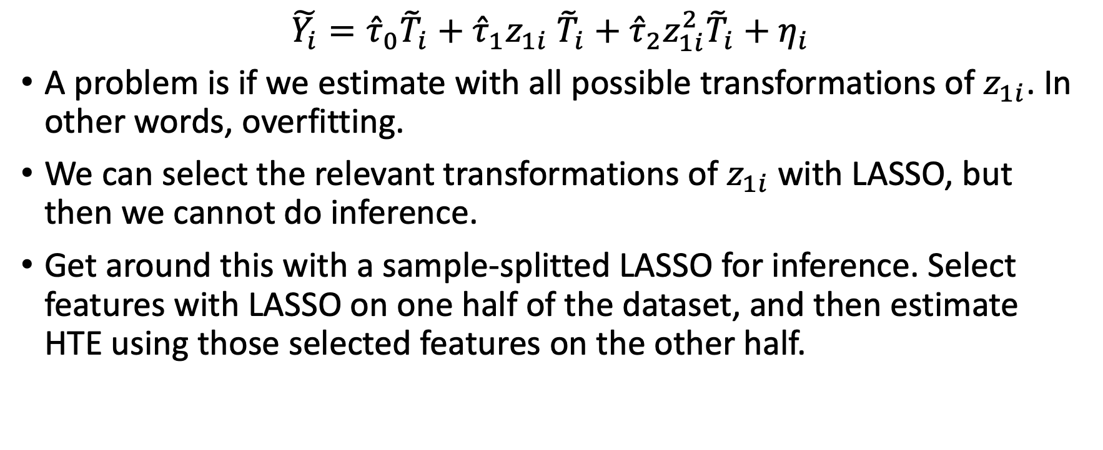
SGCT – inference with post-LASSO regression
$$\tilde{Y_{i}}={{\hat{τ}}_{0}{\tilde{T}}_{i}+\hat{τ}}_{1}z_{1i} {\tilde{T}}_{i}+{\hat{τ}}_{2}z_{1i}^{2}{\tilde{T}}_{i}+η_{i}$$
A problem is if we estimate with all possible transformations of $z_{1i}$. In other words, overfitting.
We can select the relevant transformations of $z_{1i}$ with LASSO, but then we cannot do inference.
Get around this with a sample-splitted LASSO for inference. Select features with LASSO on one half of the dataset, and then estimate HTE using those selected features on the other half.

Slide 15
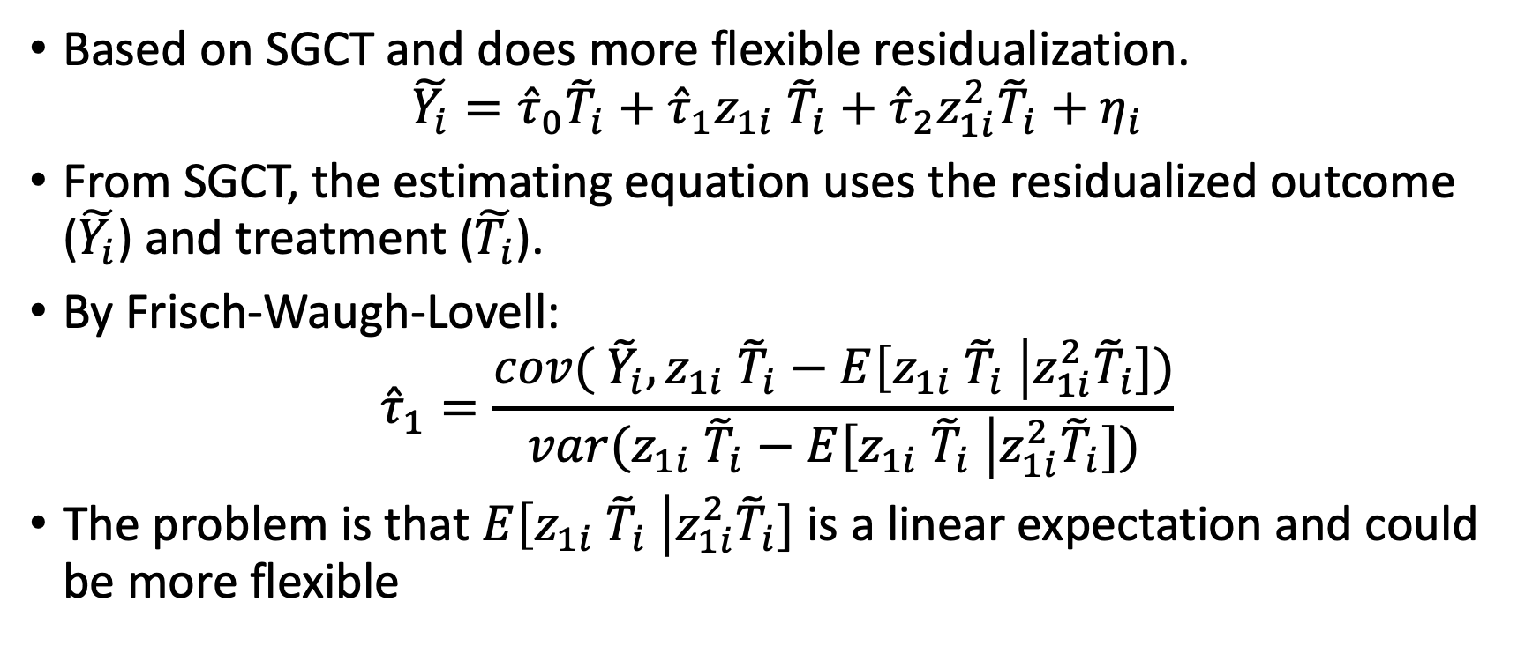
Heterogeneous residuals (HR)
Based on SGCT and does more flexible residualization.
$$\tilde{Y_{i}}={{\hat{τ}}_{0}{\tilde{T}}_{i}+\hat{τ}}_{1}z_{1i} {\tilde{T}}_{i}+{\hat{τ}}_{2}z_{1i}^{2}{\tilde{T}}_{i}+η_{i}$$
From SGCT, the estimating equation uses the residualized outcome ($\tilde{Y_{i}}$) and treatment ($\tilde{T_{i}}$).
By Frisch-Waugh-Lovell:
$${\hat{τ}}_{1}=\frac{cov( {\tilde{Y}}_{i},z_{1i} {\tilde{T}}_{i}−E\left[z_{1i} {\tilde{T}}_{i} \right|z_{1i}^{2}{\tilde{T}}_{i}])}{var(z_{1i} {\tilde{T}}_{i}−E\left[z_{1i} {\tilde{T}}_{i} \right|z_{1i}^{2}{\tilde{T}}_{i}])}$$
The problem is that $E\left[z_{1i} {\tilde{T}}_{i} \right|z_{1i}^{2}{\tilde{T}}_{i}]$ is a linear expectation and could be more flexible
Notes:
There is a minor point here about how reasonable it is to condition on the squared version of a variable. However, we can make the same argument if instead of $z_{1i}$, we had $z_{2i}$. Note the argument ${\tilde{T}}_{i}$ contains information about the other covariates does not hold because by construction it has to be uncorrelated with other features.
The linear expectation is done because OLS implicitly does a linear expectation for residualization. You can see this yourself if you were to use OLS (without any cross-fitting) in a simple DML model.

Slide 16
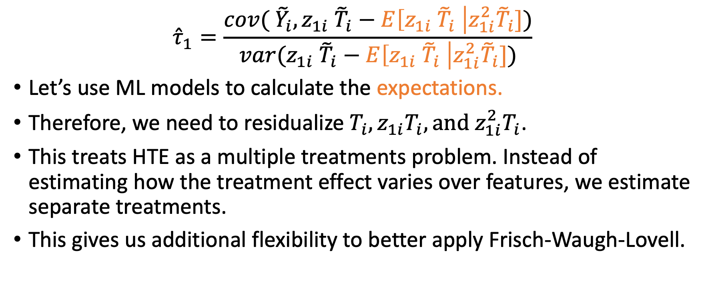
HR – flexible residualization
$${\hat{τ}}_{1}=\frac{cov( {\tilde{Y}}_{i},z_{1i} {\tilde{T}}_{i}−E\left[z_{1i} {\tilde{T}}_{i} \right|z_{1i}^{2}{\tilde{T}}_{i}])}{var(z_{1i} {\tilde{T}}_{i}−E\left[z_{1i} {\tilde{T}}_{i} \right|z_{1i}^{2}{\tilde{T}}_{i}])}$$
Let’s use ML models to calculate the expectations.
Therefore, we need to residualize $T_{i}, z_{1i}T_{i},{\text{and} z_{1i}^{2}T}_{i}$.
This treats HTE as a multiple treatments problem. Instead of estimating how the treatment effect varies over features, we estimate separate treatments.
This gives us additional flexibility to better apply Frisch-Waugh-Lovell.

Slide 17
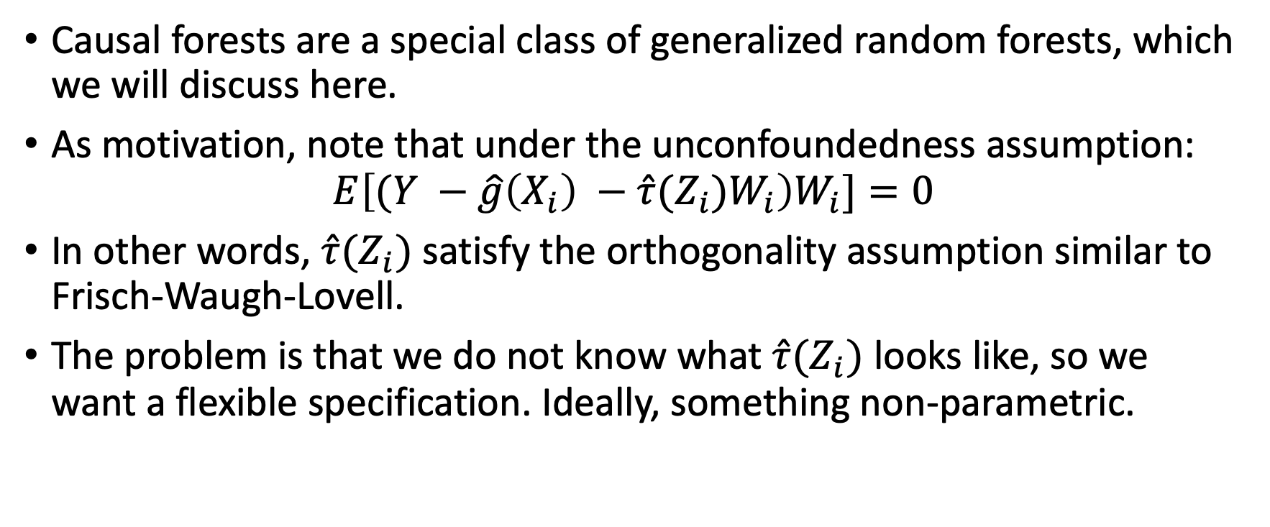
Generalized Random Forests
Causal forests are a special class of generalized random forests, which we will discuss here.
As motivation, note that under the unconfoundedness assumption:
$$E\left[(Y −\hat{g}\left(X_{i}\right) −\hat{τ}{(Z_{i})W}_{i}\right)W_{i}]=0$$
In other words, $\hat{τ}(Z_{i})$ satisfy the orthogonality assumption similar to Frisch-Waugh-Lovell.
The problem is that we do not know what $\hat{τ}(Z_{i})$ looks like, so we want a flexible specification. Ideally, something non-parametric.

Slide 18
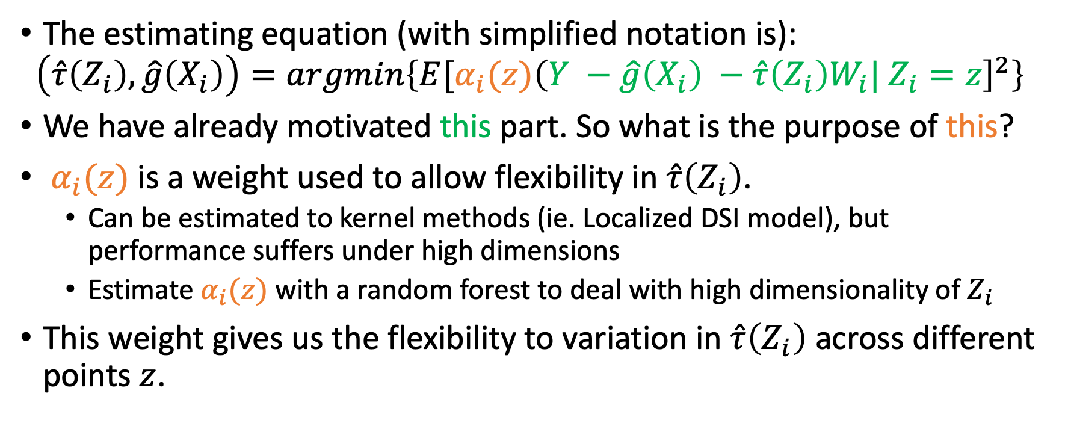
GRF – Causal Forest Objective Function
The estimating equation (with simplified notation is):
$$\left(\hat{τ}\left(Z_{i}\right), \hat{g}\left(X_{i}\right)\right)=argmin\left\{E[α_{i}(z){\left(Y −\hat{g}\left(X_{i}\right) −\hat{τ}{\left(Z_{i}\right)W}_{i}| Z_{i}=z\right]}^{2}\right\}$$
We have already motivated this part. So what is the purpose of this?
$α_{i}(z)$ is a weight used to allow flexibility in $\hat{τ}\left(Z_{i}\right)$.
Can be estimated to kernel methods (ie. Localized DSI model), but performance suffers under high dimensions
Estimate $α_{i}(z)$ with a random forest to deal with high dimensionality of $Z_{i}$
This weight gives us the flexibility to variation in $\hat{τ}\left(Z_{i}\right)$ across different points $z$.

Slide 19

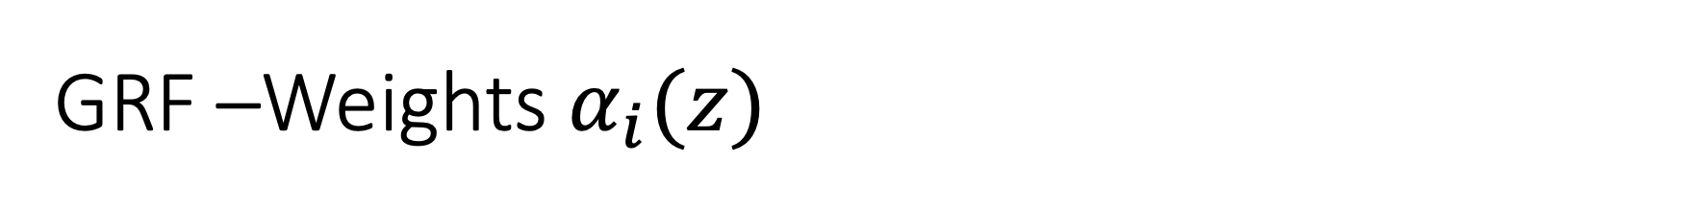
GRF –Weights $α_{i}(z)$
$α_{i}(z)$ represents the probability that a training sample $i$ falls into the same leaf as sample $z$, across different trees in a random forest.
See GRF / Appendix for the technical definition of $α_{i}(z)$ $.$
Splits in the random forest used to estimate $α_{i}(z)$ are determined to maximize variation $\hat{τ}\left(Z_{i}\right)$ across splits

Slide 20
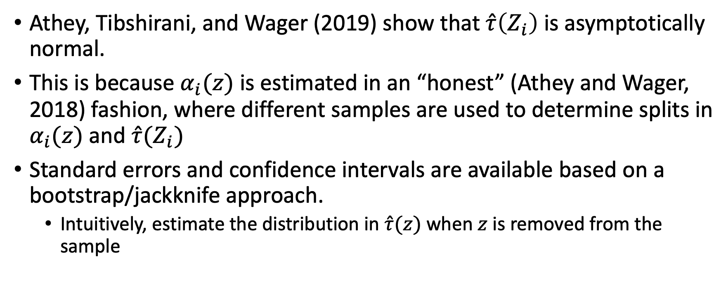
GRF - Inference
Athey, Tibshirani, and Wager (2019) show that $\hat{τ}\left(Z_{i}\right)$ is asymptotically normal.
This is because $α_{i}(z)$ is estimated in an “honest” (Athey and Wager, 2018) fashion, where different samples are used to determine splits in $α_{i}(z)$ and $\hat{τ}(Z_{i})$
Standard errors and confidence intervals are available based on a bootstrap/jackknife approach.
Intuitively, estimate the distribution in $\hat{τ}(z)$ when $z$ is removed from the sample

Slide 21
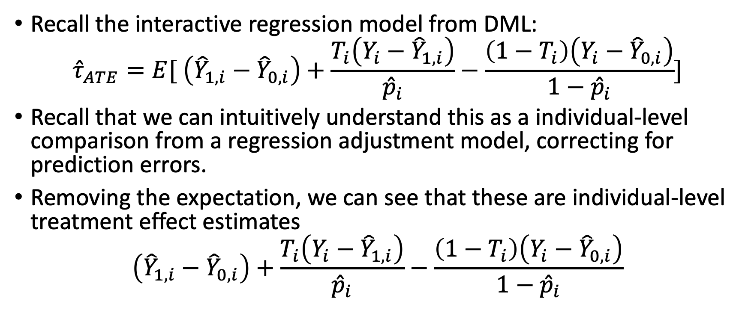
Doubly Robust – Kennedy (2020)
Recall the interactive regression model from DML:
$${\hat{τ}}_{ATE}=E[ \left({\hat{Y}}_{1,i}−{\hat{Y}}_{0,i}\right)+\frac{T_{i}\left(Y_{i}−{\hat{Y}}_{1,i}\right)}{{\hat{p}}_{i}}−\frac{\left(1−T_{i}\right)\left(Y_{i}−{\hat{Y}}_{0,i}\right)}{1−{\hat{p}}_{i}}]$$
Recall that we can intuitively understand this as a individual-level comparison from a regression adjustment model, correcting for prediction errors.
Removing the expectation, we can see that these are individual-level treatment effect estimates
$$\left({\hat{Y}}_{1,i}−{\hat{Y}}_{0,i}\right)+\frac{T_{i}\left(Y_{i}−{\hat{Y}}_{1,i}\right)}{{\hat{p}}_{i}}−\frac{\left(1−T_{i}\right)\left(Y_{i}−{\hat{Y}}_{0,i}\right)}{1−{\hat{p}}_{i}}$$

Slide 22
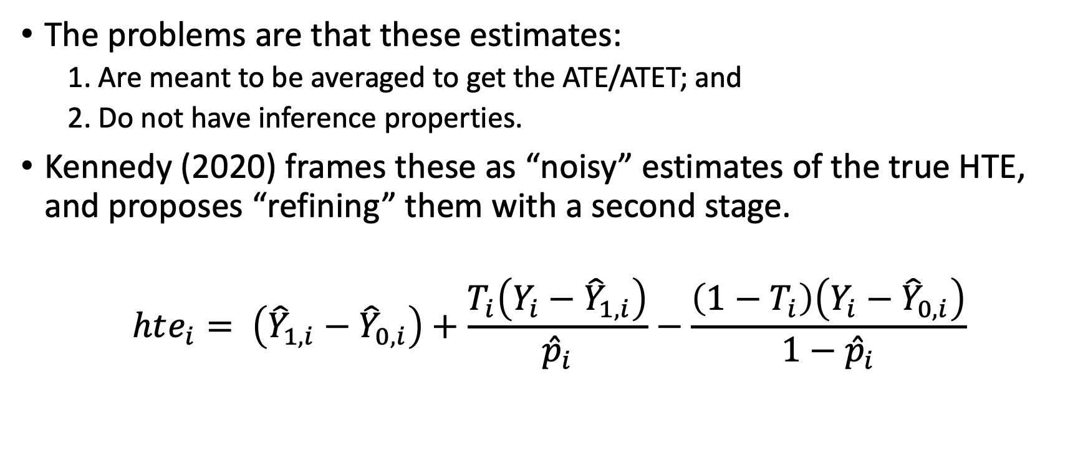
Applying inference to the individual estimates
The problems are that these estimates:
1. Are meant to be averaged to get the ATE/ATET; and
2. Do not have inference properties.
Kennedy (2020) frames these as “noisy” estimates of the true HTE, and proposes “refining” them with a second stage.
$$hte_{i}= \left({\hat{Y}}_{1,i}−{\hat{Y}}_{0,i}\right)+\frac{T_{i}\left(Y_{i}−{\hat{Y}}_{1,i}\right)}{{\hat{p}}_{i}}−\frac{\left(1−T_{i}\right)\left(Y_{i}−{\hat{Y}}_{0,i}\right)}{1−{\hat{p}}_{i}}$$
Notes:
You *could* do bootstrapping of the individual-level estimates, but that would be very computationally intensive procedure.

Slide 23

Refining estimates with a second stage
Kennedy (2020) proposes applying a regression model to the “noisy” estimates of the true HTE, $hte_{i}$.
OLS
Kernel regression
Cross-splitted LASSO regressions

Slide 24
Simulation Study

Slide 25
Context
Recall, HTE models are not about estimating the average effect, but rather the functional form of treatment effects.
The additional complexity of functional form can make this very difficult.
We will demonstrating using simulation evidence, where we can change the true HTE function

Slide 26
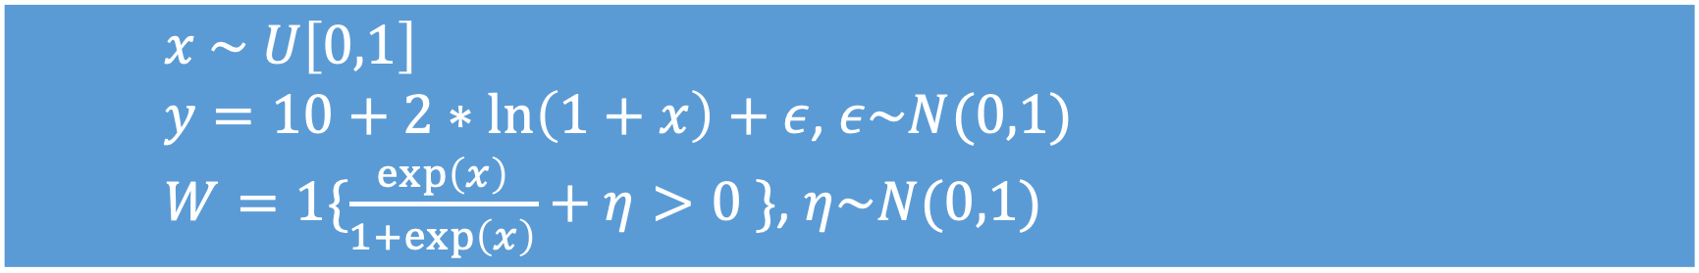
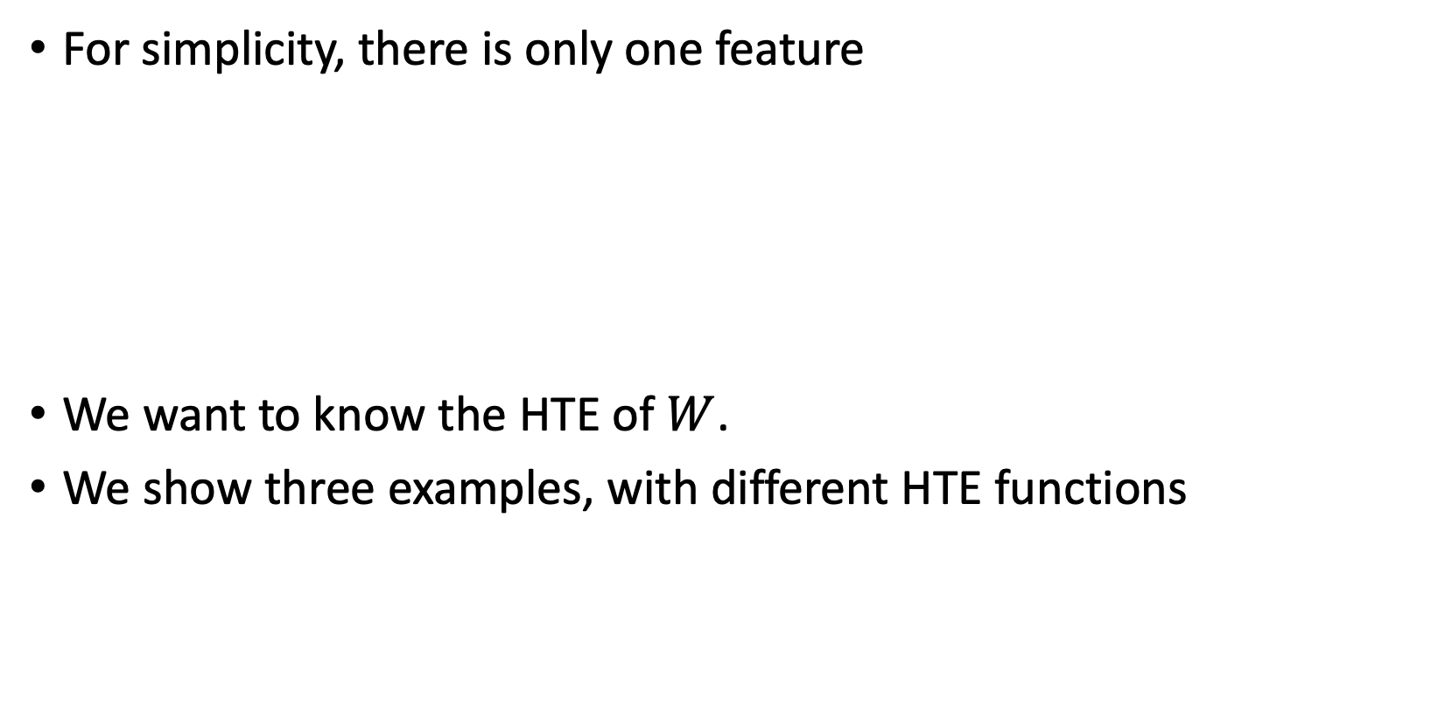
General Simulation Context
For simplicity, there is only one feature
We want to know the HTE of $W$.
We show three examples, with different HTE functions
$x \sim U\left[0,1\right]$
$y=10+2∗\ln\left(1+x\right)+ε$, $ε\sim N(0,1)$
$W=1\{\frac{\exp\left(x\right)}{1+\exp\left(x\right)}+η>0 \}\text{, }η\sim N(0,1\text{)}$

Slide 27
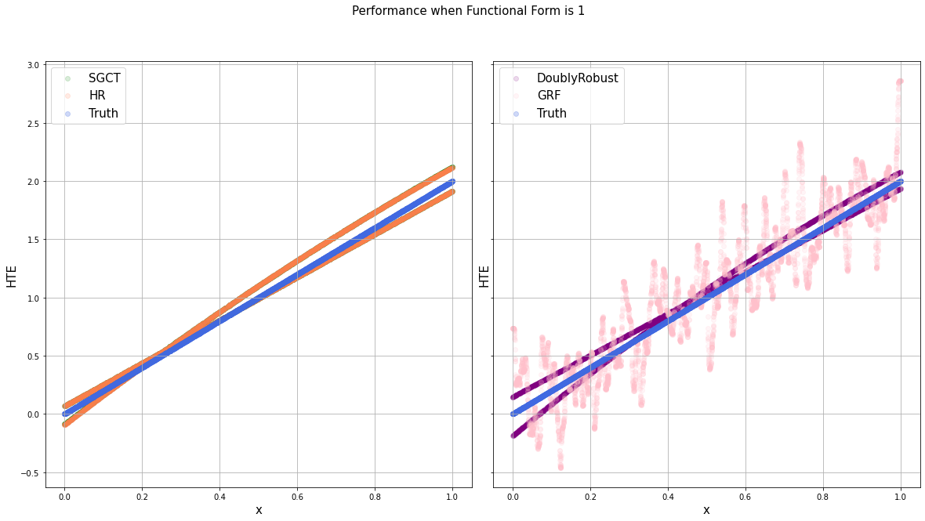
First Example – Linearity
$HTE\left(x\right)=2x$
Model controls: $x, x^{2}$

Slide 28
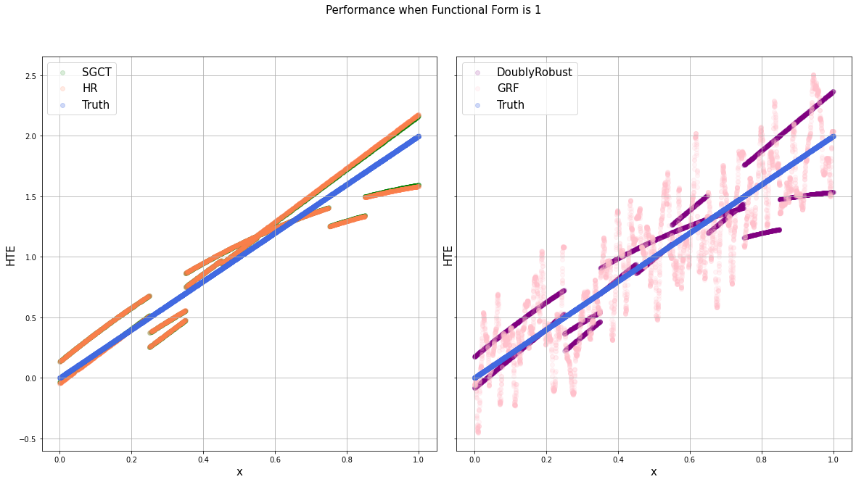
First Example – Linearity with more controls
$HTE\left(x\right)=2x$
Model controls: $x, x^{2}, 1\left\{0≥x>0.2\right\},1\left\{0.2≥x>0.4\right\},$… $1\left\{0.8≥x>1\right\},$

Slide 29
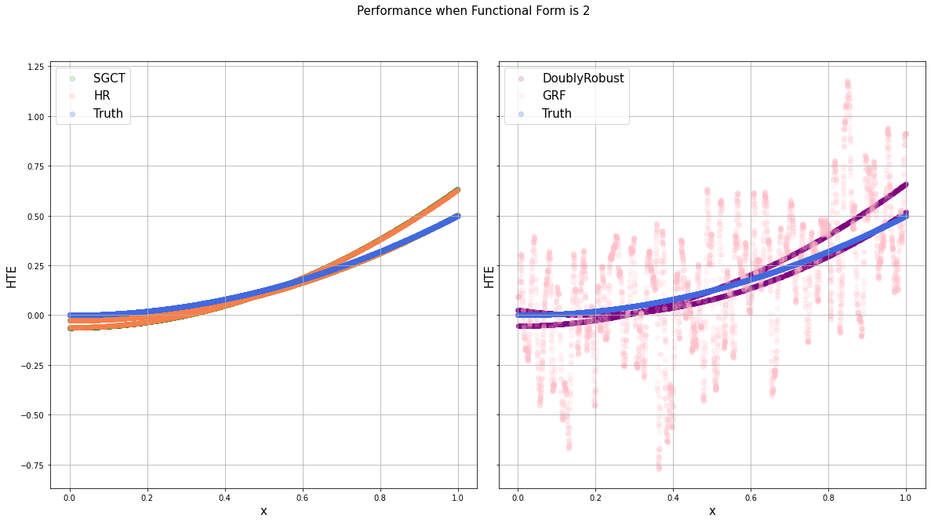
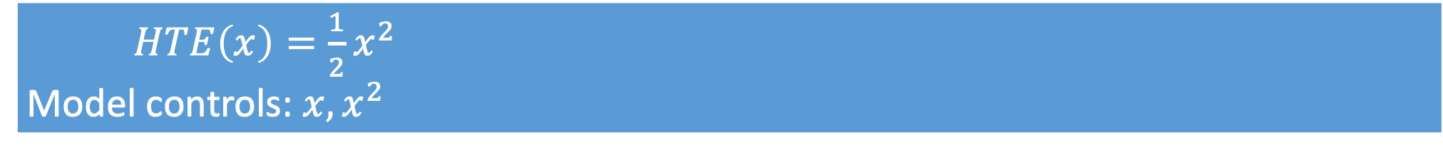
Second Example – Quadratics
$HTE\left(x\right)=\frac{1}{2}x^{2}$
Model controls: $x, x^{2}$

Slide 30
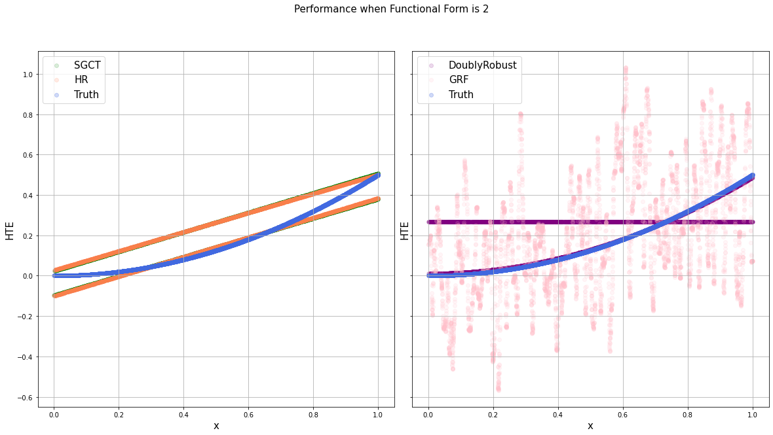
Second Example – Quadratics with more controls
$HTE\left(x\right)=2x$
Model controls: $x, x^{2}, 1\left\{0≥x>0.2\right\},1\left\{0.2≥x>0.4\right\},$… $1\left\{0.8≥x>1\right\},$

Slide 31
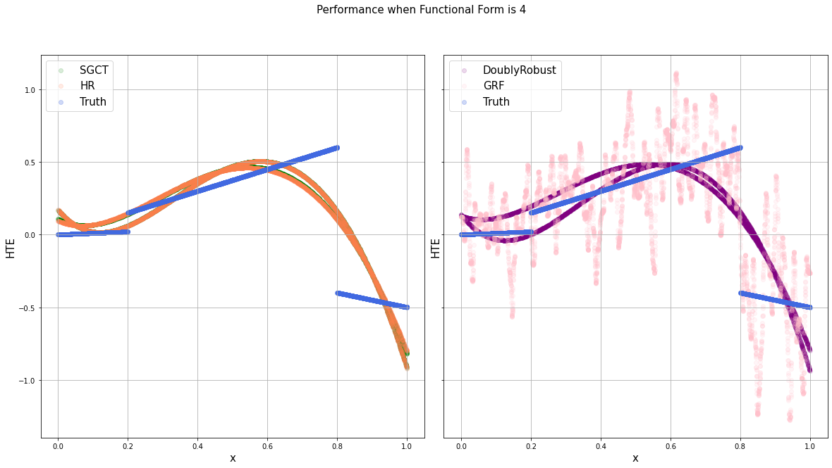
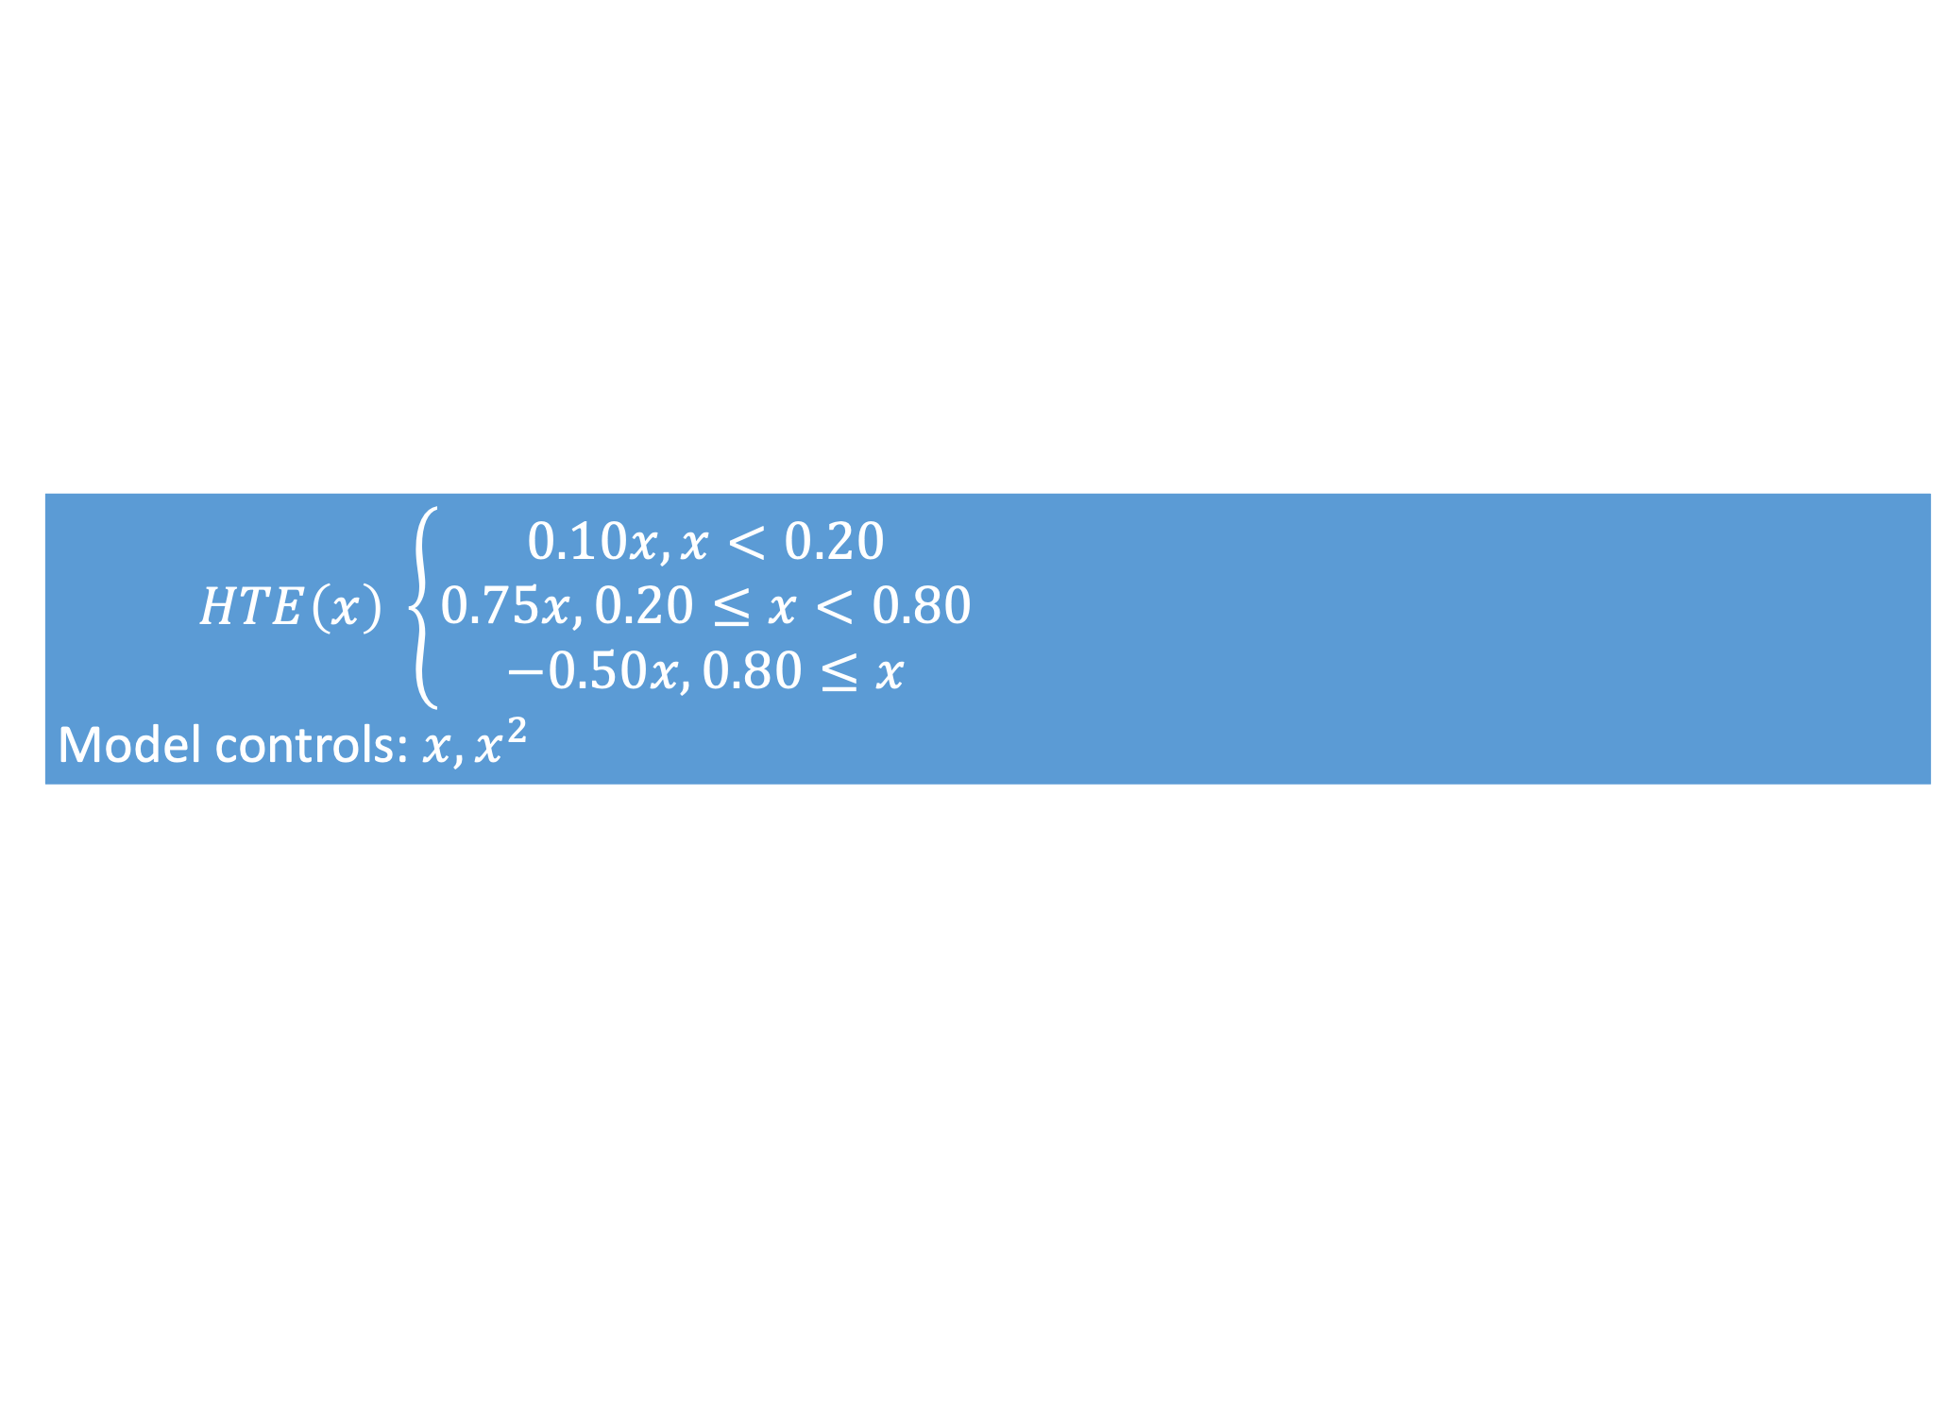
Third Example – Piece-wise
$HTE\left(x\right) \left\{\begin{aligned}0.10x, x<0.20 \\ 0.75x, 0.20≤x<0.80 \\ −0.50x, 0.80≤x\end{aligned}\right.$
Model controls: $x, x^{2}$

Slide 32
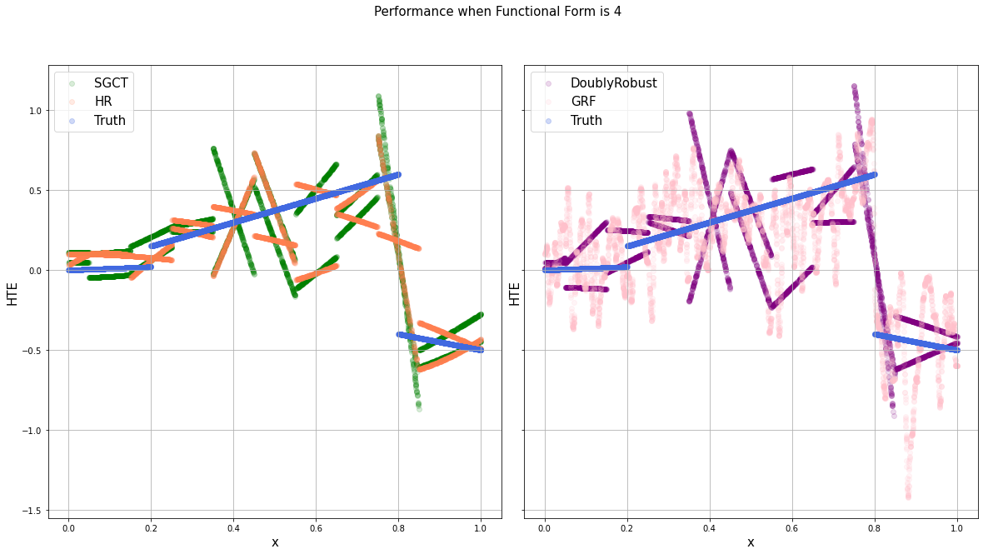
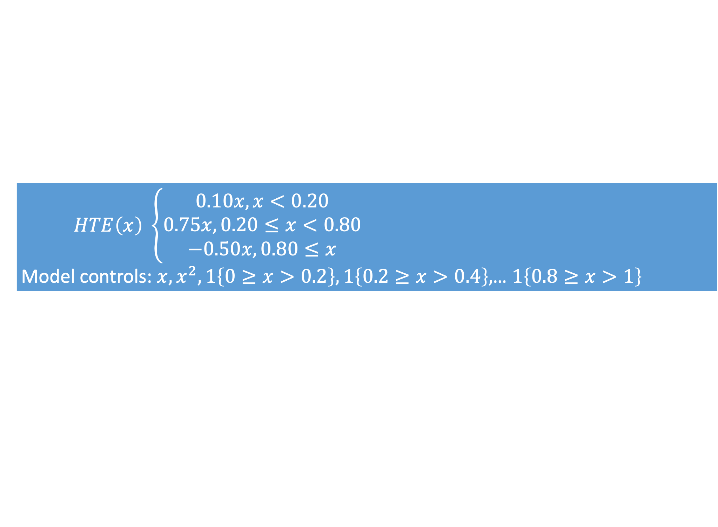
Third Example – Piece-wise with more controls
$HTE\left(x\right) \left\{\begin{aligned}0.10x, x<0.20 \\ 0.75x, 0.20≤x<0.80 \\ −0.50x, 0.80≤x\end{aligned}\right.$
Model controls: $x, x^{2}, 1\left\{0≥x>0.2\right\},1\left\{0.2≥x>0.4\right\},$… $1\left\{0.8≥x>1\right\}$

Slide 33
Takeaways
Including more features to estimate a more flexible HTE may not necessarily increase performance.
The more complicated, or more fine-grained, you want HTE estimates to be, the more data you need.

Slide 34
Review and Conclusion
Covered the additional complexities and challenges of estimating HTE
Covered a parametric (DML, HR) and non-parametric (forests) models
Deep neural network models (Farrell et. al 2020) not covered because of code availability
Demonstration with simulated data
Notes:
Farrell et al’s DNN code can be found in the Support Information here: https://onlinelibrary.wiley.com/doi/abs/10.3982/ECTA16901?af=R

Slide 35
Causal Inference Series
Foundations
Defining Some ATE/ATET Causal Models
ATE/ATET Inference, Asymptotic Theory, and Bootstrapping
Best Practices: Outliers, Class Imbalance, Feature Selection, and Bad Control [skipped for now]
Heterogeneous Treatment Effect Models and Inference
Difference-in-Difference Models for Panel Data
Regression Discontinuity Models
Arguable Validation

Slide 36
Appendix Slides

